Slide 1
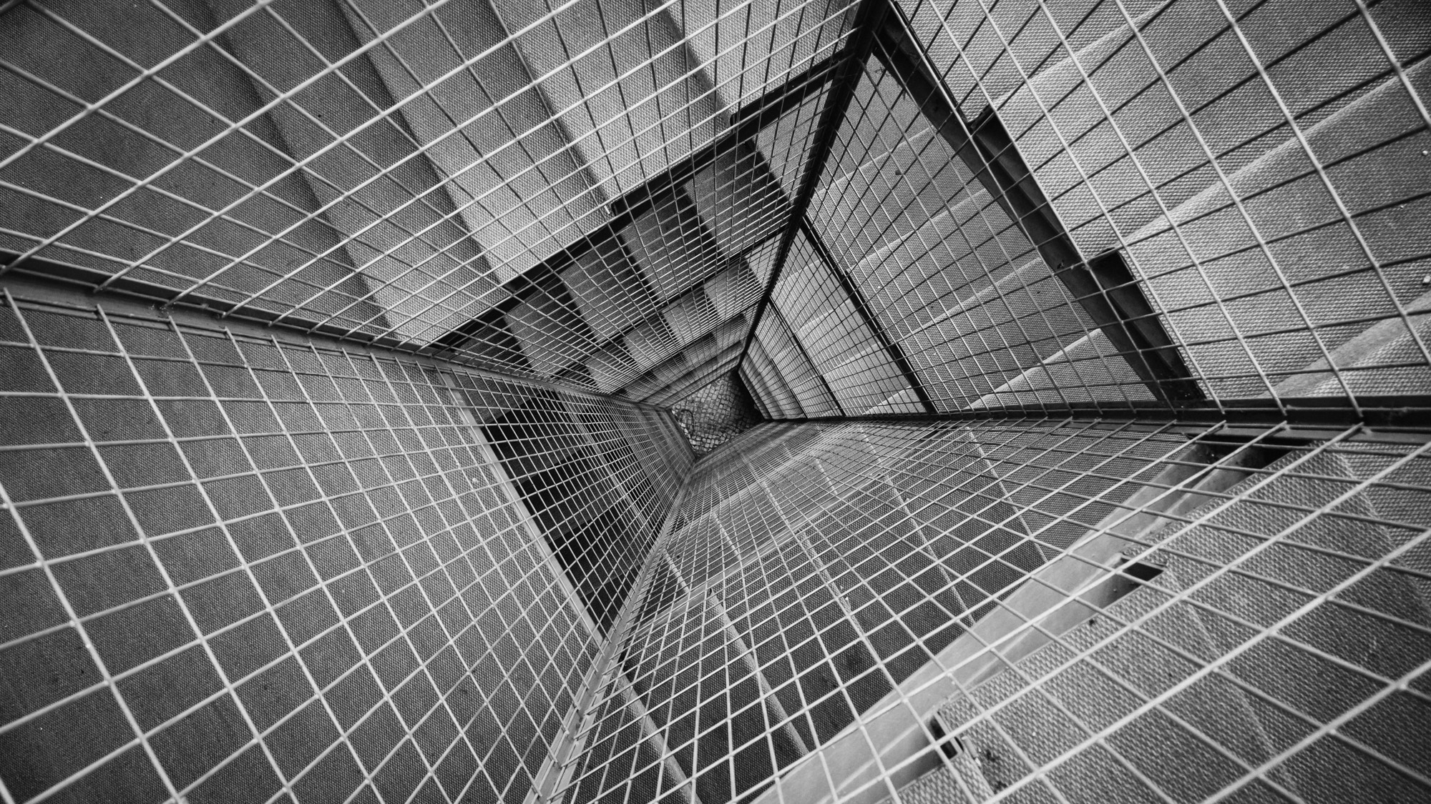
Diamonds Regression Project
Done by : Mariam Samara, Sebail Biltaji

Slide 2

1. Looking at the big picture:
Frame the problem:
It is a supervised learning task since we are given labeled training examples.
It is a regression task since we are asked to predict a value.
It is a multiple regression problem; since the system will use multiple features to make a prediction( it will use the clarity, cut , color , depth, etc..).
Batch learning is fine, since there is no continuous flow of data coming into the system.

Slide 3
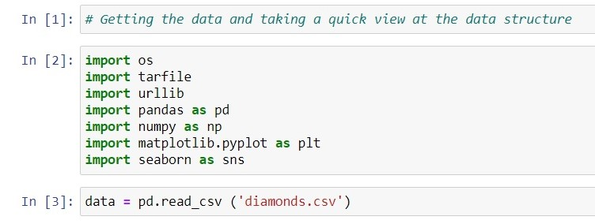
2. Getting the Data:
We started our project by adding comments before every step, marking each step as to not get lost and making it easy for any other potential reader to understand our project
Next we imported all the important libraries that we might use and finally, we downloaded the data

Slide 4
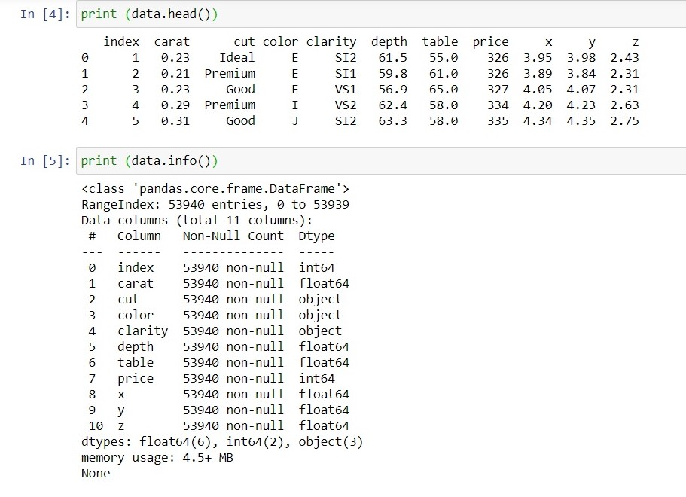
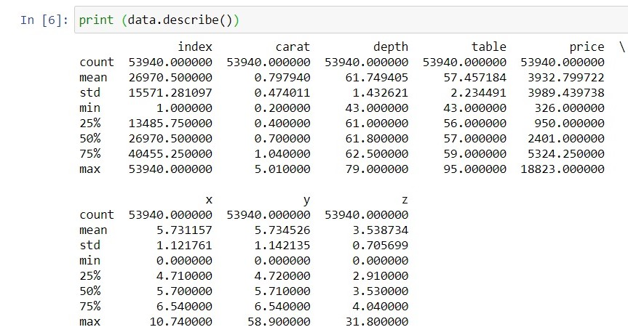
Taking a quick look at the data structure
Next, we took a quick look at the data structure (the head, info, and description of the data)

Slide 5
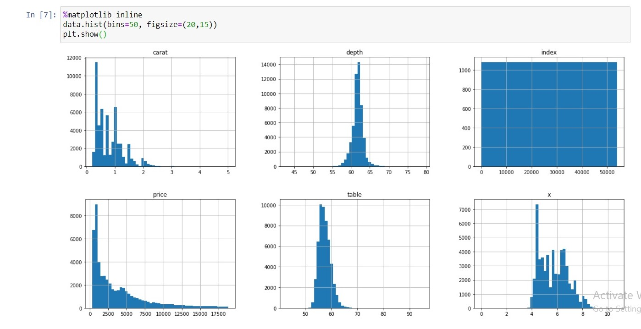
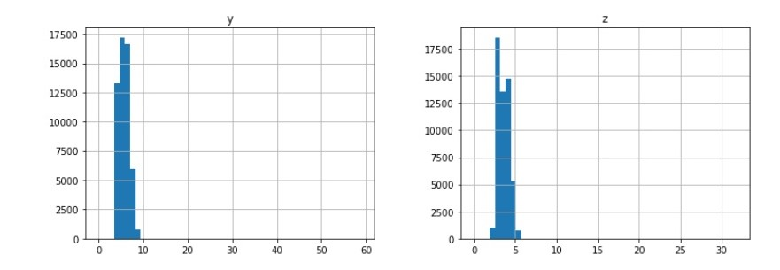
Another way to get the feel of the data and take a good look at it, is to plot a histogram…

Slide 6
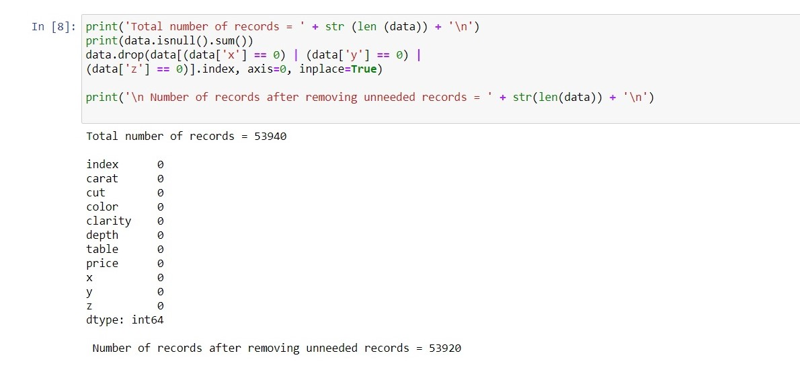
Here we had to check to see if we had any null values in any of the attributes.

Slide 7
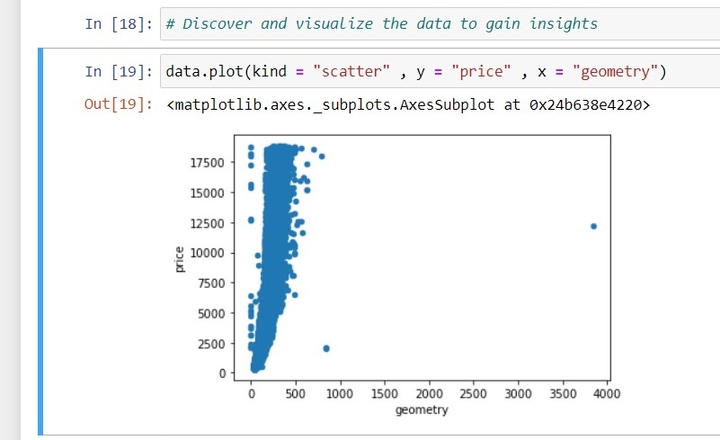
Discovering and visualizing the data to gain insight:
The next few slides will contain different types of plots and graphs that help us gain a deep understanding of the data that we are trying to manipulate.
This scatter plot is giving us a relation between the geometry (or size) of the diamonds and their price.

Slide 8
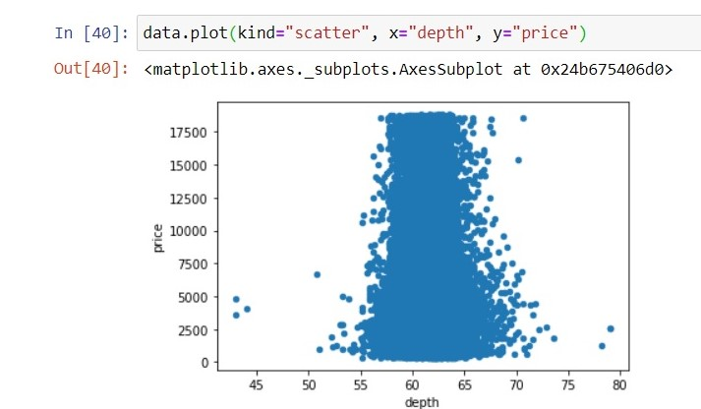
This graph is another scatter that shows the relation between the price and the depth.

Slide 9
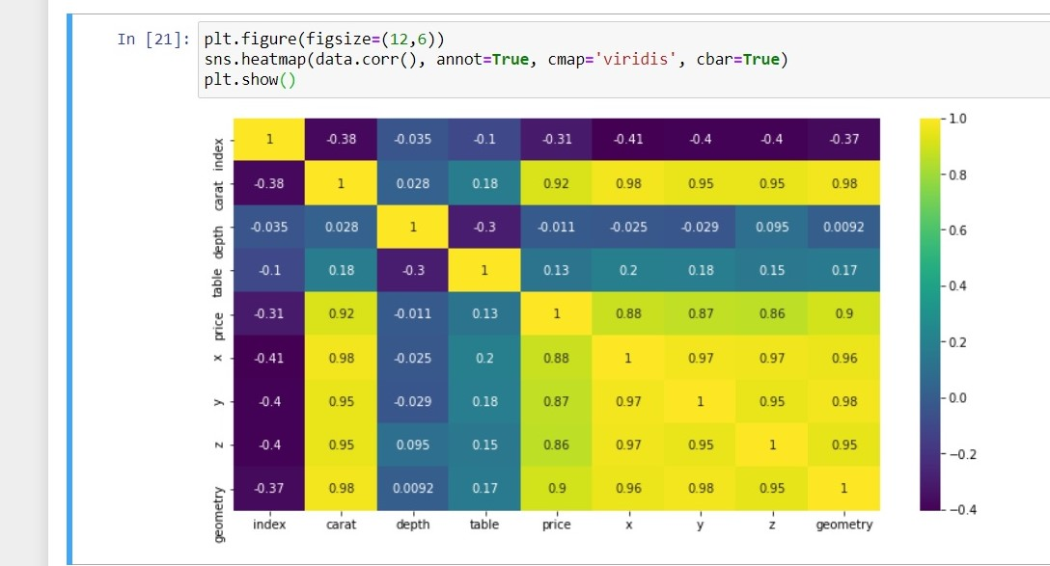
This is a heat map that shows the relation between almost all the attributes that we have.

Slide 10
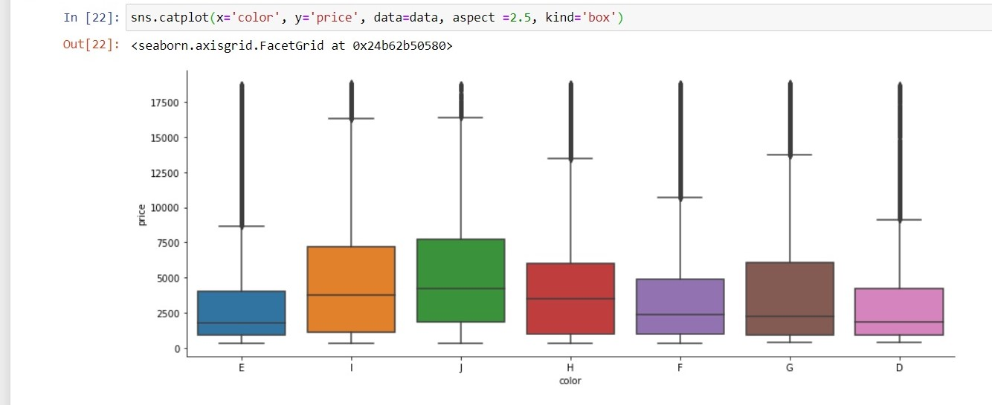
This is a catplot that shows the relation between the color and price.

Slide 11
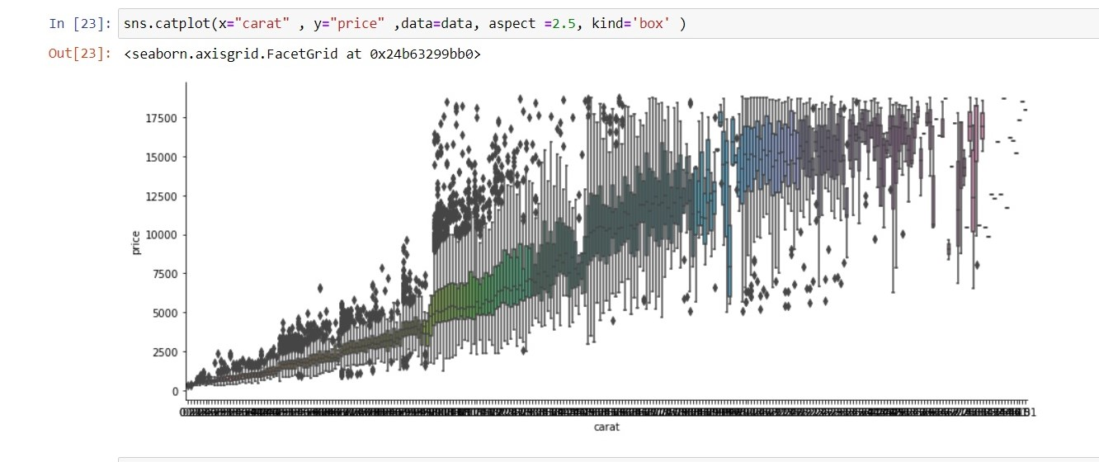
This is another catplot showing the relation between the price and carats.

Slide 12
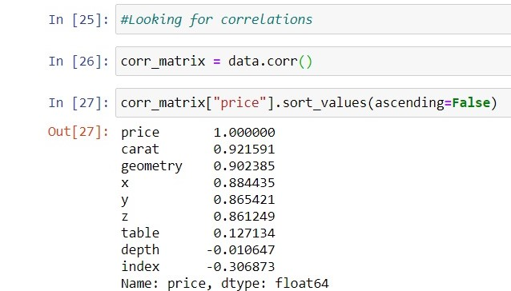
We looked at how much each attribute correlates to the price using the standard correlation coefficient.
The correlation coefficient ranges from –1 to 1.
The price tends to go up when the carats go up.

Slide 13
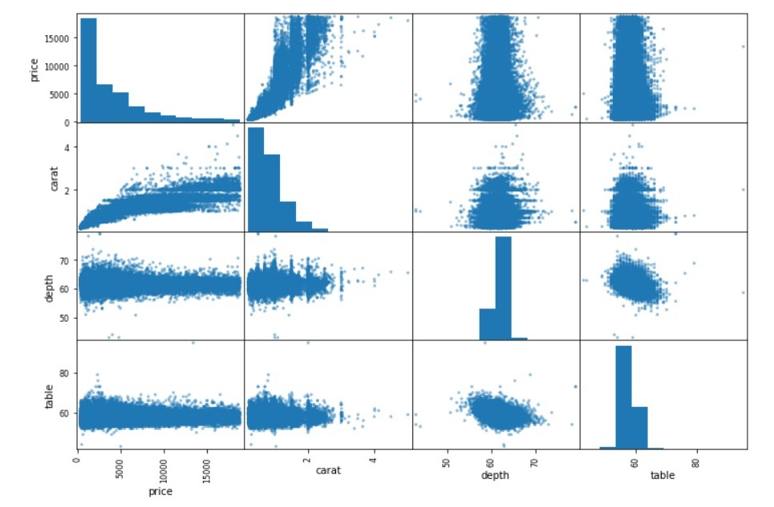
We also checked for correlations between the attributes using the pandas scatter_matrix() function.

Slide 14
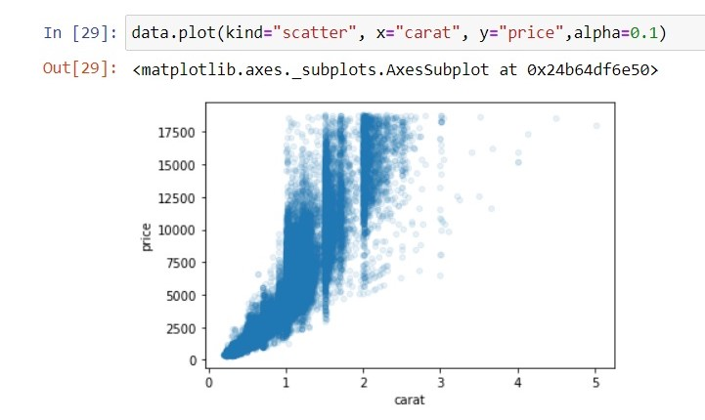
We saw that the most promising attribute to predict the price is the carats, so we zoomed in on their correlation scatterplot.
This plot reveals that this correlation is indeed very strong, we can clearly see the upward trend, and the points are not too dispersed

Slide 15
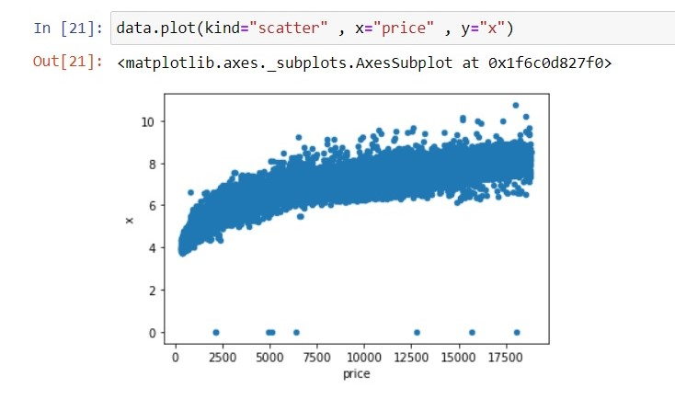
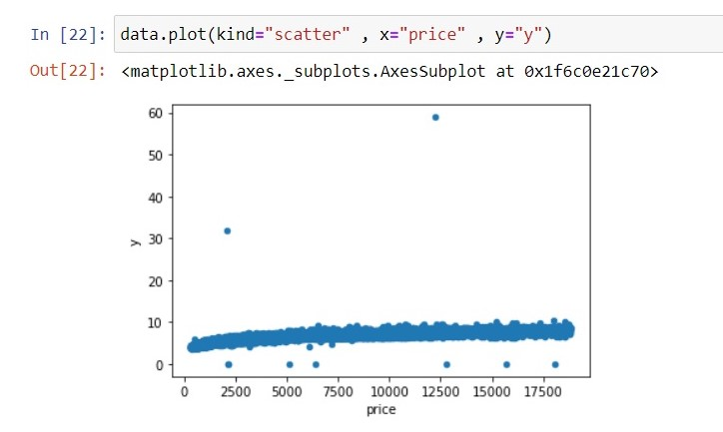
Here we viewed the correlations between the price and x and the price and y.

Slide 16
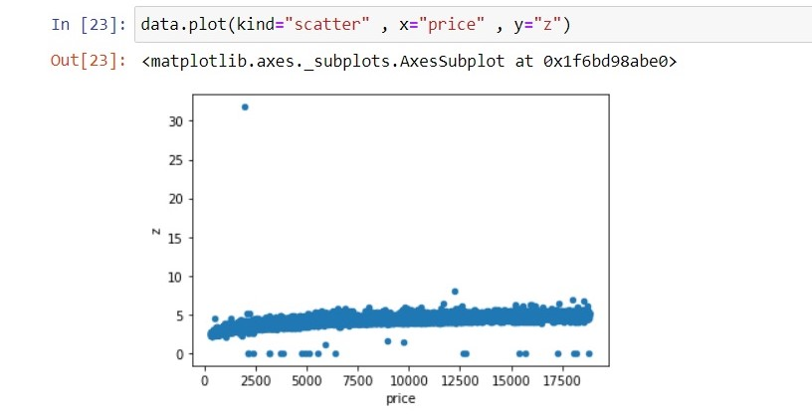
Here is the correlation between the price and z.

Slide 17

Preparing the data for machine learning algorithms

Slide 18
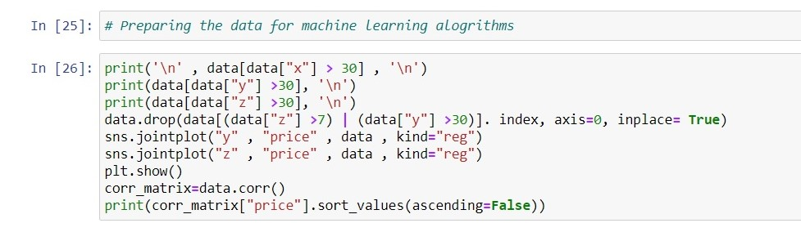
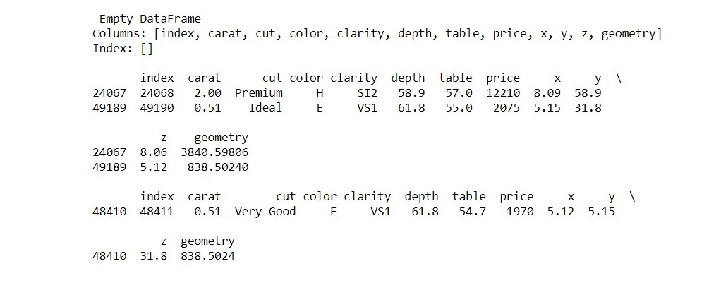
Removing Outliers
We found out that we have 3 records that contain anomalous values and decided to remove them as they might make it harder for the system to detect the underlying patterns.

Slide 19
Introducing the new attribute ‘geometry’
data['geometry'] = data['x'] * data['y'] * data['z']
print('correlations after')
corr_matrix = data.corr()
print(corr_matrix['price'].sort_values(ascending=False))
data.drop('x', axis=1, inplace=True)
data.drop('y', axis=1, inplace=True)
data.drop('z', axis=1, inplace=True)
data.drop('Unnamed: 0', axis=1, inplace=True)
we tried combining all of the diamonds dimentions
into one attribute and compared the correlations afterwards

Slide 20
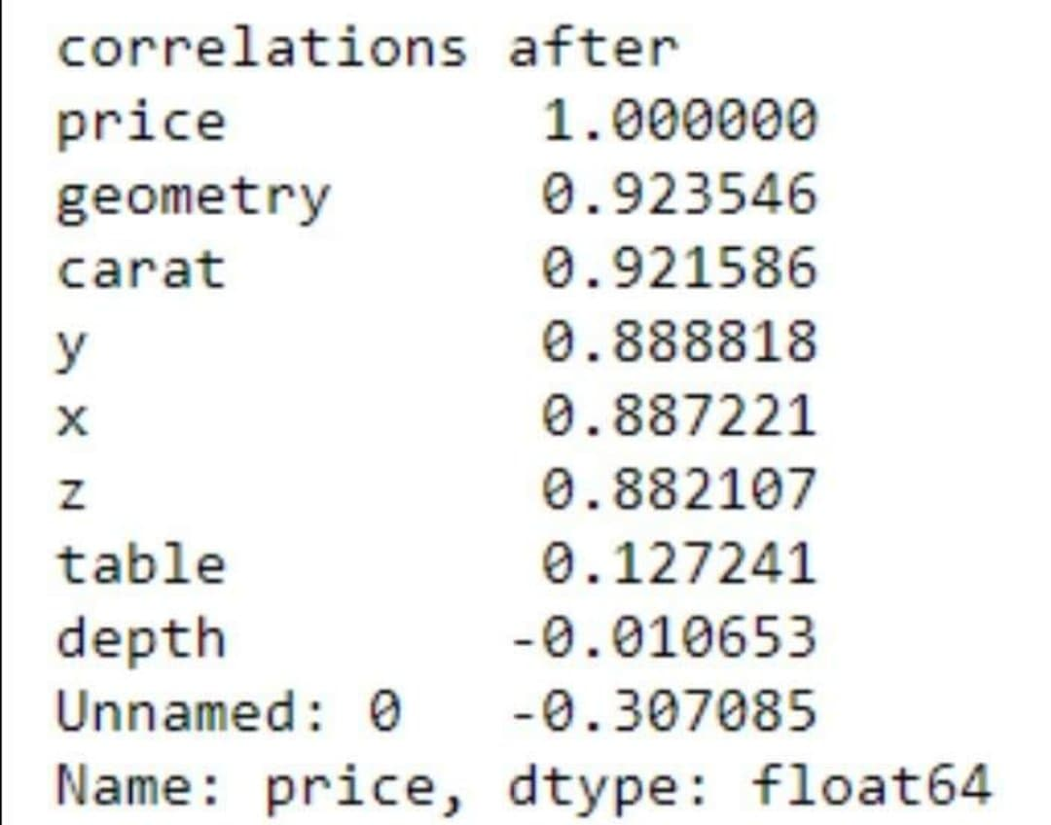
Correlations after adding the new attribute
We found that the correlation between geometry and the price is better than the correlation between x , y and z individually and the price.

Slide 21
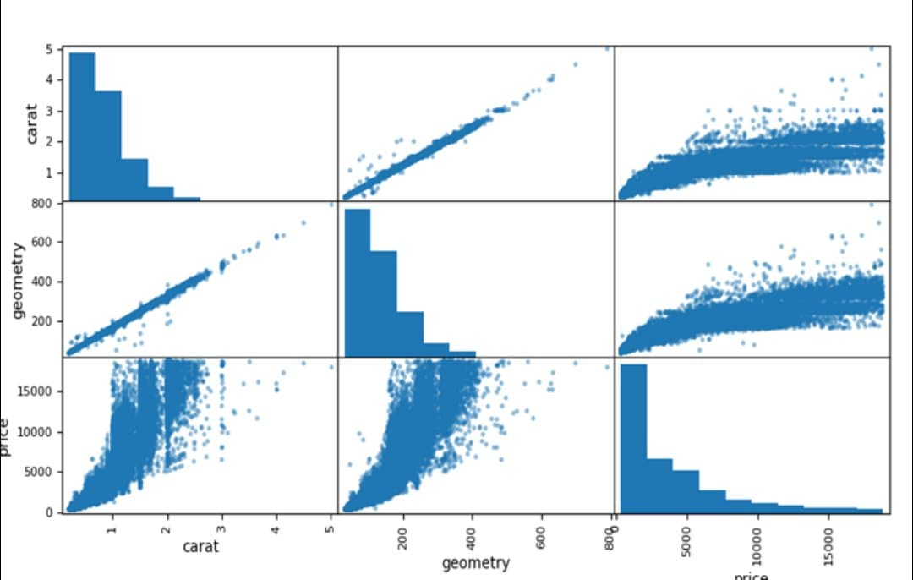
Correlation between carat, geometry and price.

Slide 22
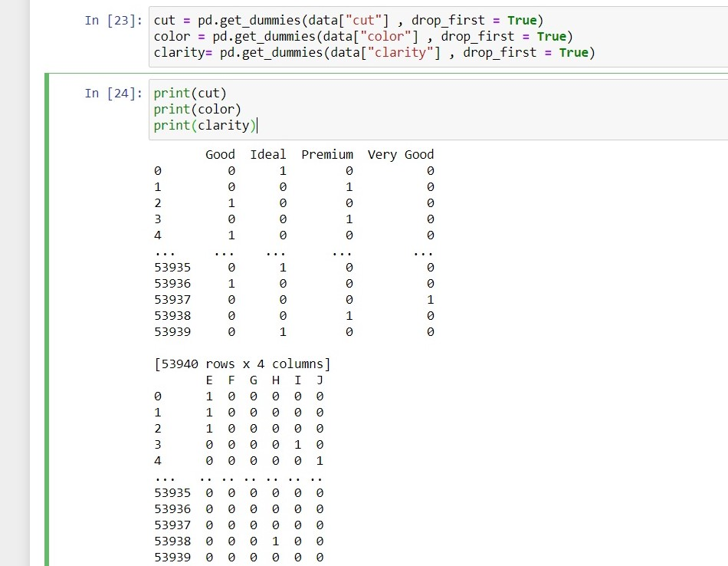
Preparing the data for machine learning algorithms:
We realized that there are no missing (or null) values. Which made the data almost perfect. However, we still had text attributes to contend with, so we started this step by handling text and categorical attributes.
We tried a lot of methods for this step, but we found all of them too complicated and long, we eventually found a method that was both easy and simple, which is: adding a new data frame to our dataset with the categories as columns

Slide 23
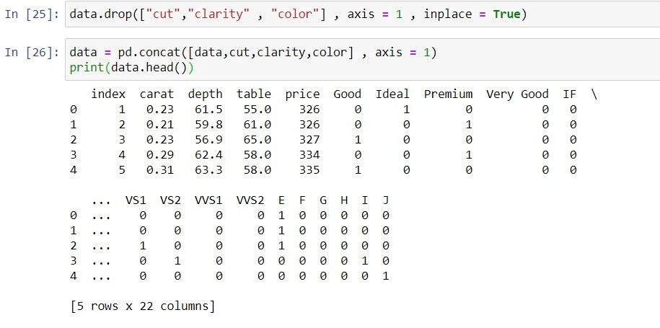
Preparing the data for machine learning algorithms:
We used the “pd.get_dummies” function to convert each column to a data frame. We also dropped the “cut”, ”clarity” and “color” columns to make sure that they don’t cause any harm to our code.

Slide 24
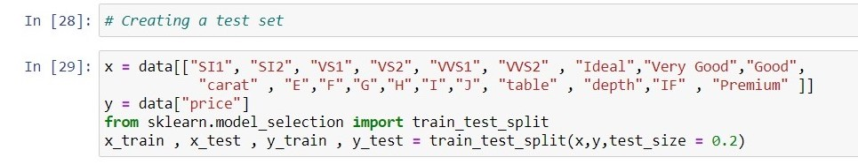
Creating a test set:
The train-test split procedure is used to estimate the performance of machine learning algorithms when they are used to make predictions on data not used to train the model. By splitting the data, we have created a test set from a portion of out training set.

Slide 25
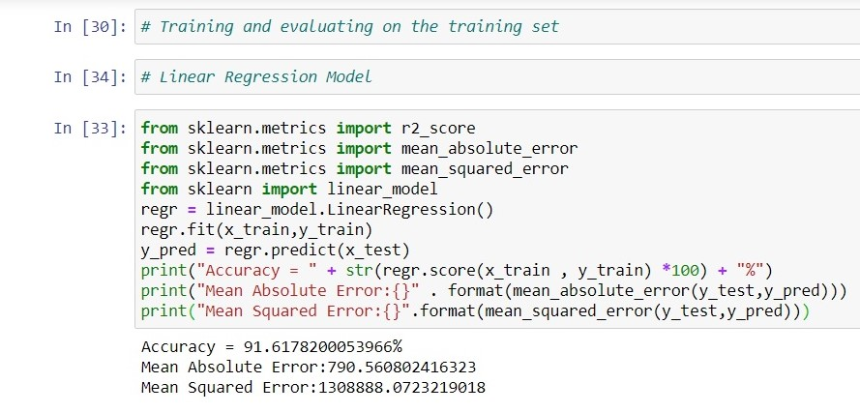
Selecting and training a model:
In this step we started training different training model, we calculated the accuracy, the mean absolute error and the mean squared error, compared these values to the other training models we tried and found the best one.
This slide we trained the Linear Regression Model, it worked, but the predictions were not exactly accurate, so we moved on to the model.

Slide 26
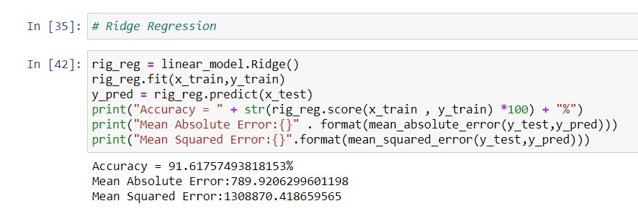
Here we tried, the Ridge Regression Model, we noticed that the results were almost the same as the Linear Regression Model.

Slide 27
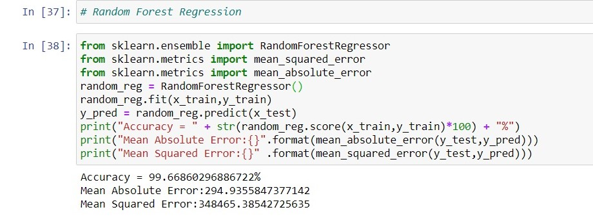
The Random Forest Regression Model gave the best results. Therefore, we decided that it was the best model for out training data.

Slide 28
THANK YOU

